Slide 1
Campus Facility Object Detection Using SSD

Slide 2
Data Collection and processing
Data Collection and Partitioning:
The dataset contains 472 annotated images with three object categories: car, chair, and lamp post.
The data was partitioned into 80% training, 10% validation, and 10% test sets.
Data Augmentation and Processing :
To improve model generalization, data augmentation techniques were applied:
Resizing: Images were resized to 300x300 pixels to match the input size of the SSD.
Normalization: Mean subtraction and standard deviation normalization were applied to the images.
Transformations: Random flips and color jittering were used for augmentation.

Slide 3
Data Collection and processing
Task: The goal is to implement object detection using a fine-tuned SSD model with the VGG-16 backbone, focusing on detecting Campus objects .
Link to the dataset: Project 2_DL Dataset
Number of samples, image size: The dataset contains 472 annotated images, and each image is resized to 300x300 pixels to match the SSD model input size.
Number of classes: There are three object classes: car, chair, and lamp post.
Train, test, and validation partition: The data is split into 80% for training, 10% for validation, and 10% for testing
Data Normalization (mean and standard deviation):
Normalization: Applied to input images to match pre-trained models' expectations.
Mean: [0.485, 0.456, 0.406] adjusts image color channels.
Standard Deviation: [0.229, 0.224, 0.225] scales values for consistency.
Normalization ensures images are in a similar range as those used to train the base model, improving model performance.
Data augmentation techniques:
Outputs per Example: 3 versions for diversity
Flip: Horizontal to add variation
Rotation: ±10° for handling slight tilts
Shear: ±10° Horizontal/Vertical for perspective robustness
Saturation/Brightness: Adjusted ±10% to simulate lighting and color variations

Slide 4
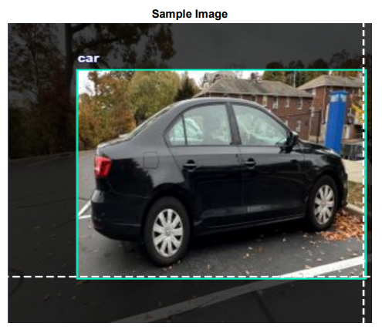
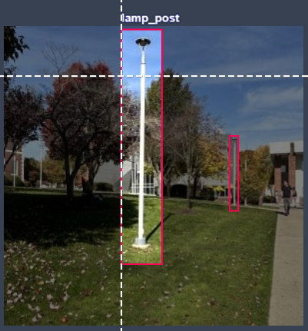
Sample images

Slide 5
Data structure of labels for one sample
<annotation>
<folder/>
<filename>car_29_jpeg.rf.f667a53241b9e3a3124641dd2f86753a.jpg</filename>
<path>car_29_jpeg.rf.f667a53241b9e3a3124641dd2f86753a.jpg</path>
<source>
<database>roboflow.com</database>
</source>
<size>
<width>300</width>
<height>300</height>
<depth>3</depth>
</size>
<segmented>0</segmented>
<object>
<name>car</name>
<pose>Unspecified</pose>
<truncated>0</truncated>
<difficult>0</difficult>
<occluded>0</occluded>
<bndbox>
<xmin>7</xmin>
<xmax>301</xmax>
<ymin>1</ymin>
<ymax>294</ymax>
</bndbox>
</object>
</annotation>

Slide 6
NN Architecture
Input Image (300x300)
Feature Extractor (VGG16 Backbone)
Conv Block 1: Conv2d → ReLU → MaxPool
Conv Block 2: Conv2d → ReLU → MaxPool
Conv Block 3: Conv2d → ReLU → MaxPool
Conv Block 4: Conv2d → ReLU → MaxPool
Conv Block 5: Conv2d → ReLU → MaxPool
Extra Feature Layers (for Multi-Scale Detection)
Extra Conv Layer 1: Conv2d → ReLU
Anchor Generation (Default Box Generator)
Extra Conv Layer 2: Conv2d → ReLU
Extra Conv Layer 3: Conv2d → ReLU
Generates Default Bounding Boxes
Uses different aspect ratios and scales
Prediction Heads
Classification Head
Conv2d Layers
Predicts Class Scores for Each Box
Regression Head
Conv2d Layers
Predicts Bounding Box Offsets
Output Transform (Post Processing)
Normalization
Resize to Desired Output
Output Predictions (Bounding Boxes + Class Labels)

Slide 7
Loss function Architecture
Input Predictions
Ground Truth
Classification Loss Calculation (Cross-Entropy)
Regression Loss Calculation (Smooth L1)
Total Loss Calculation
Final Loss for Backpropagation

Slide 8
NN model from pytorch
SSD( (backbone): SSDFeatureExtractorVGG( (features): Sequential( (0): Conv2d(3, 64, kernel_size=(3, 3), stride=(1, 1), padding=(1, 1)) (1): ReLU(inplace=True) (2): Conv2d(64, 64, kernel_size=(3, 3), stride=(1, 1), padding=(1, 1)) (3): ReLU(inplace=True) (4): MaxPool2d(kernel_size=2, stride=2, padding=0, dilation=1, ceil_mode=False) (5): Conv2d(64, 128, kernel_size=(3, 3), stride=(1, 1), padding=(1, 1)) (6): ReLU(inplace=True) (7): Conv2d(128, 128, kernel_size=(3, 3), stride=(1, 1), padding=(1, 1)) (8): ReLU(inplace=True) (9): MaxPool2d(kernel_size=2, stride=2, padding=0, dilation=1, ceil_mode=False) (10): Conv2d(128, 256, kernel_size=(3, 3), stride=(1, 1), padding=(1, 1)) (11): ReLU(inplace=True) (12): Conv2d(256, 256, kernel_size=(3, 3), stride=(1, 1), padding=(1, 1)) (13): ReLU(inplace=True) (14): Conv2d(256, 256, kernel_size=(3, 3), stride=(1, 1), padding=(1, 1)) (15): ReLU(inplace=True) (16): MaxPool2d(kernel_size=2, stride=2, padding=0, dilation=1, ceil_mode=True) (17): Conv2d(256, 512, kernel_size=(3, 3), stride=(1, 1), padding=(1, 1)) (18): ReLU(inplace=True) (19): Conv2d(512, 512, kernel_size=(3, 3), stride=(1, 1), padding=(1, 1)) (20): ReLU(inplace=True) (21): Conv2d(512, 512, kernel_size=(3, 3), stride=(1, 1), padding=(1, 1)) (22): ReLU(inplace=True) )

Slide 9
NN model from pytorch
(extra): ModuleList( (0): Sequential( (0): MaxPool2d(kernel_size=2, stride=2, padding=0, dilation=1, ceil_mode=False) (1): Conv2d(512, 512, kernel_size=(3, 3), stride=(1, 1), padding=(1, 1)) (2): ReLU(inplace=True) (3): Conv2d(512, 512, kernel_size=(3, 3), stride=(1, 1), padding=(1, 1)) (4): ReLU(inplace=True) (5): Conv2d(512, 512, kernel_size=(3, 3), stride=(1, 1), padding=(1, 1)) (6): ReLU(inplace=True) (7): Sequential( (0): MaxPool2d(kernel_size=3, stride=1, padding=1, dilation=1, ceil_mode=False) (1): Conv2d(512, 1024, kernel_size=(3, 3), stride=(1, 1), padding=(6, 6), dilation=(6, 6)) (2): ReLU(inplace=True) (3): Conv2d(1024, 1024, kernel_size=(1, 1), stride=(1, 1)) (4): ReLU(inplace=True) ) )

Slide 10
NN model from pytorch
(1): Sequential( (0): Conv2d(1024, 256, kernel_size=(1, 1), stride=(1, 1)) (1): ReLU(inplace=True) (2): Conv2d(256, 512, kernel_size=(3, 3), stride=(2, 2), padding=(1, 1)) (3): ReLU(inplace=True) ) (2): Sequential( (0): Conv2d(512, 128, kernel_size=(1, 1), stride=(1, 1)) (1): ReLU(inplace=True) (2): Conv2d(128, 256, kernel_size=(3, 3), stride=(2, 2), padding=(1, 1)) (3): ReLU(inplace=True) ) (3-4): 2 x Sequential( (0): Conv2d(256, 128, kernel_size=(1, 1), stride=(1, 1)) (1): ReLU(inplace=True) (2): Conv2d(128, 256, kernel_size=(3, 3), stride=(1, 1)) (3): ReLU(inplace=True) ) ) )

Slide 11
NN model from pytorch
(anchor_generator): DefaultBoxGenerator(aspect_ratios=[[2], [2, 3], [2, 3], [2, 3], [2], [2]], clip=True, scales=[0.07, 0.15, 0.33, 0.51, 0.69, 0.87, 1.05], steps=[8, 16, 32, 64, 100, 300]) (head): SSDHead( (classification_head): SSDClassificationHead( (module_list): ModuleList( (0): Conv2d(512, 364, kernel_size=(3, 3), stride=(1, 1), padding=(1, 1)) (1): Conv2d(1024, 546, kernel_size=(3, 3), stride=(1, 1), padding=(1, 1)) (2): Conv2d(512, 546, kernel_size=(3, 3), stride=(1, 1), padding=(1, 1)) (3): Conv2d(256, 546, kernel_size=(3, 3), stride=(1, 1), padding=(1, 1)) (4-5): 2 x Conv2d(256, 364, kernel_size=(3, 3), stride=(1, 1), padding=(1, 1)) ) ) (regression_head): SSDRegressionHead( (module_list): ModuleList( (0): Conv2d(512, 16, kernel_size=(3, 3), stride=(1, 1), padding=(1, 1)) (1): Conv2d(1024, 24, kernel_size=(3, 3), stride=(1, 1), padding=(1, 1)) (2): Conv2d(512, 24, kernel_size=(3, 3), stride=(1, 1), padding=(1, 1)) (3): Conv2d(256, 24, kernel_size=(3, 3), stride=(1, 1), padding=(1, 1)) (4-5): 2 x Conv2d(256, 16, kernel_size=(3, 3), stride=(1, 1), padding=(1, 1)) ) ) ) (transform): GeneralizedRCNNTransform( Normalize(mean=[0.48235, 0.45882, 0.40784], std=[0.00392156862745098, 0.00392156862745098, 0.00392156862745098]) Resize(min_size=(300,), max_size=300, mode='bilinear') ) )

Slide 12
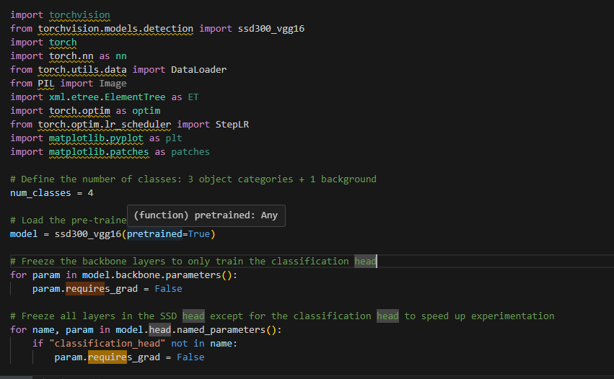
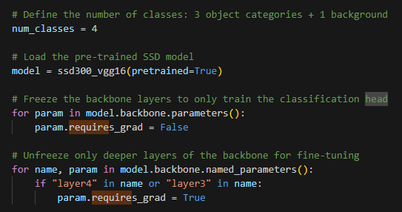
Transfer Learning
A snapshot of the code where we froze earlier part of the network.

Slide 13
Training
Mini-batch size: 4
Optimization algorithm and its hyperparameter settings (e.g., learning rate, weight decay):

Slide 14
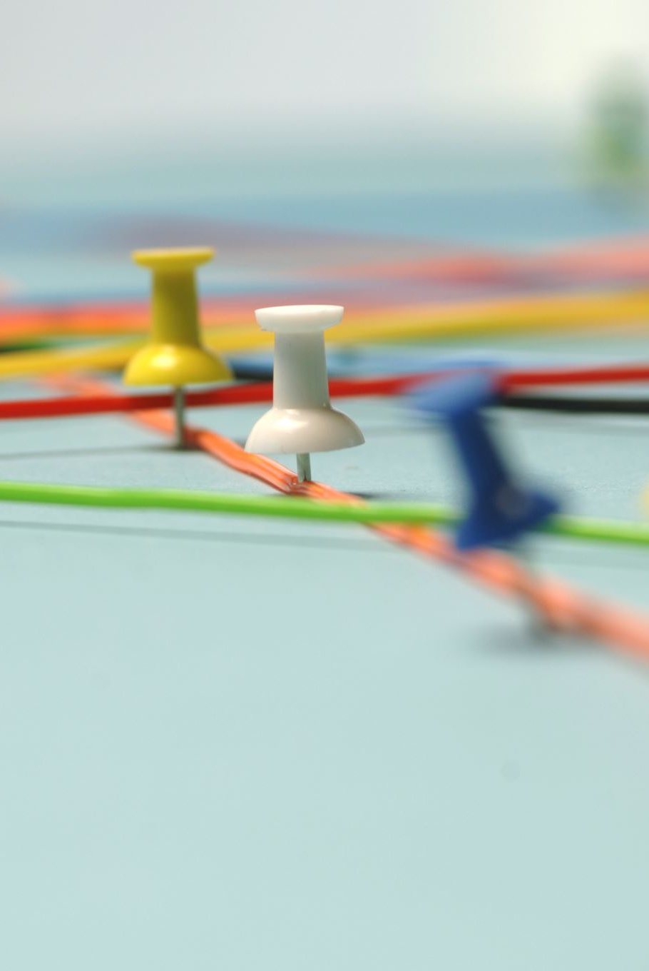
Training
Hyperparameter Search:
For this project, the hyperparameter search was done manually by selecting reasonable values for learning rate, momentum, and weight decay. Specifically, the initial learning rate was 0.001 during the initial training phase and was reduced to 0.0001 during fine-tuning to allow the model to make smaller updates for better convergence.
The StepLR scheduler was also used with a step size of 3 and a gamma value of 0.1 to gradually reduce the learning rate during training. This helps in refining the model and potentially achieving a lower loss over time

Slide 15
Pre and post training comparison
MMetric | Pre-Finetuning | Post-Finetuning
Mean Average Precision (mAP) | 0.00 | 0.20
Mean IoU | 0.017 | 3.2604
Accuracy (IoU > 0.5) | 0% | 57.14%
Training Loss | 17.23 | 12.07
Validation Loss | 20.953 | 12.5302

Slide 16
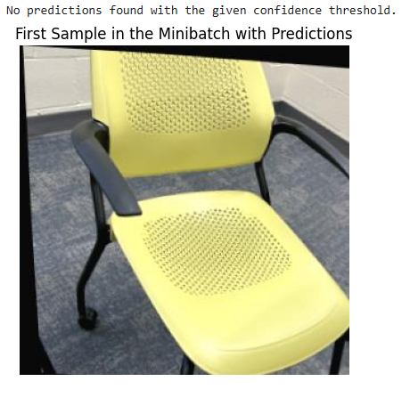
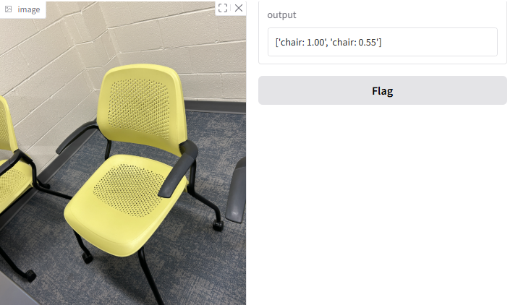
Pre and post training comparison
Comparing predictions for two samples before and after training
Before Training
After Training

Slide 17

Thank You

